Slide 1
Part 2.2: Uninformed Search
Uninformed search? Also called blind search
Uninformed search methods
  1. Depth-first search
  2. Breadth-first search
  3. Interactive deepening search
  4. Bi-directional search
Notes:
ICS611-Foundations of A.I
Part3.2 -Uninformed search

Slide 2
Uninformed Search?
Simply searches the state space (or NET).
Can only distinguish between goal state and non-goal state.
Sometimes called Blind search as it has no information or knowledge about its domain.
Notes:
ICS611-Foundations of A.I
Part3.2 -Uninformed search

Slide 3
Uninformed Search Characteristics
Blind Searches have no preference as to which state (node) that is expanded next
The different types of blind searches are characterised by the order in which they expand the nodes.
This can have a dramatic effect on how well the search performs when measured against the performance measure

Slide 4
Uninformed (Blind) Search Methods
Methods that do not use any specific knowledge about the problem.
These are:
  Depth-first search
  Breadth-first search
  Non deterministic search
  Iterative deepening search
  Bi-directional search

Slide 5
1. Depth-first Search
Expand the tree as deep as possible, returning to upper levels when needed.

Slide 6
Depth-First Search

Slide 7
Depth-first search
= Chronological backtracking i.e go back after reaching deepest point.
S
Select a child
  convention: left-to-right
Repeatedly go to next child, as long as possible.
Return to left-over alternatives (higher-up) only when needed.
A
B
C
E
D
F
G

Slide 8
Evaluation criteria:
Completeness
  Does the algorithm always find a path?
    (for every state space such that a path exits)
Speed (worst time complexity) :
  What is the highest number of nodes that may need to be created?
Memory (worst space complexity) :
  What is the largest amount of nodes that may need to be stored?
Expressed in terms of:
    d = depth of the tree
    b = (average) branching factor of the tree
    m = depth of the shallowest solution

Slide 9
Completeness (depth-first)
Complete for FINITE (implicit) NETS.
  (= State space with finitely many nodes)

Slide 10
4
4
3
A
B
C
S
5
5
G
4
3
D
2
E
F
3
S
4
4
A
D
2
5
5
B
D
A
E
4
5
2
4
5
4
C
2
E
4
5
E
B
B
F
4
4
5
4
4
3
D
F
B
F
C
E
A
C
G
3
4
3
4
G
C
G
F
3
G

Slide 11
Speed (depth-first)
In the worst case:
  the (only) goal node may be on the right-most branch,
d
b
G
Time complexity == b^{d} + b^{d-1} + … + 1 = b^{d+1} -1
Thus: O(b^{d})
b - 1

Slide 12
Memory (depth-first)
Largest number of nodes in QUEUE is reached in bottom left-most node.
Example: d = 3, b = 3 :
...
QUEUE contains all nodes. Thus: 7.
In General: ((b-1) * d) + 1
Order: O(d*b) nb. B = expanded nodes, d = depth

Slide 13
2. Breadth-first Search
Expand the tree layer by layer, progressing in depth.
In other words,
    Expand root node first
    Expand all nodes at level 1 before expanding level 2
    OR
    Expand all nodes at level d before expanding nodes at level d+1

Slide 14
Breadth-First Search

Slide 15
Breadth-first search:
S
A
Move downwards, level by level, until goal is reached.
D
B
D
A
E
C
E
E
B
B
F
D
F
B
F
C
E
A
C
G
G
C
G
F
G

Slide 16
Trace of breadth-first for running example:
(S) S removed, (SA,SD) computed and added
(SA, SD) SA removed, (SAB,SAD,SAS) computed, (SAB,SAD) added
(SD,SAB,SAD) SD removed, (SDA,SDE,SDS) computed, (SDA,SDE) added
(SAB,SAD,SDA,SDE) SAB removed, (SABA,SABE,SABC) computed, (SABE,SABC) added
(SAD,SDA,SDE,SABE,SABC) SAD removed, (SADS,SADA, SADE) computed, (SADE) added
etc, until QUEUE contains:
(SABED,SABEF,SADEB,SADEF,SDABC,SDABE,SDEBA,SDEBC, SDEFG) goal is reached: reports success

Slide 17
Completeness (breadth-first)
Complete
  even for infinite implicit NETS !
Would even remain complete without our loop-checking.
Note: ALWAYS finds the shortest path.

Slide 18
Speed (breadth-first)
If a goal node is found on depth m of the tree, all nodes up till that depth are created.
m
d
b
G
Thus: O(b^{m})
note: depth-first would also visit deeper nodes.
Notes:
ICS611-Foundations of A.I
Part3.2 -Uninformed search

Slide 19
Memory (breadth-first)
Largest number of nodes in QUEUE is reached on the level m of the goal node.
m
d
b
G
QUEUE contains all and nodes. (Thus: 4) .
In General: b^{m}
This usually is MUCH worse than depth-first !!
G

Slide 20
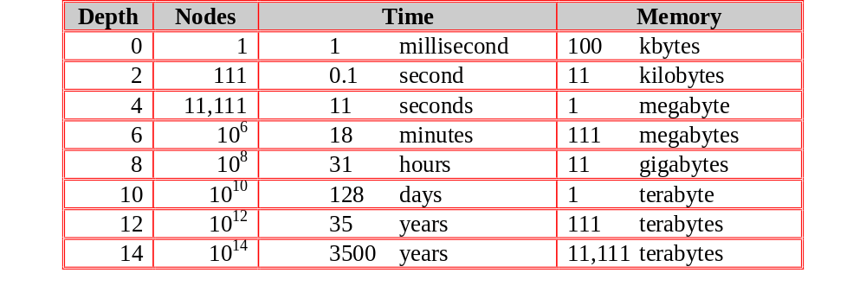
Exponential Growth (breadth-first)
Time and memory requirements for breadth-first search, assuming a branching factor of 10, 100 bytes per node and searching 1000 nodes/second

Slide 21
Exponential Growth - Observations
Space is more of a factor to breadth first search than time
Time is still an issue. Who has 35 years to wait for an answer to a level 12 problem (or even 128 days to a level 10 problem)
It could be argued that as technology gets faster then exponential growth will not be a problem. But even if technology is 100 times faster we would still have to wait 35 years for a level 14 problem and what if we hit a level 15 problem!

Slide 22
Practical evaluation:
1.Depth-first search:
  IF the search space contains very deep branches without solution, THEN Depth-first may waist much time in them. Very demanding on time!!
2. Breadth-first search:
  Is VERY demanding on memory!!
Solutions ??
  Non-deterministic search
  Iterative deepening

Slide 23
3. Iterative deepening Search
Restrict a depth-first search to a fixed depth.
If no path was found, increase the depth and restart the search.

Slide 24
Depth-limited search:
1. DEPTH <-- <some natural number>
QUEUE <-- path only containing the root;
2. WHILE QUEUE is not empty
AND goal is not reached
DO remove the first path from the QUEUE;
IF path has length smaller than DEPTH
create new paths (to all children);
reject the new paths with loops;
add the new paths to front of QUEUE;
3. IF goal reached
THEN success;
ELSE failure;

Slide 25
Iterative deepening algorithm: we increase the depth limit gradually from 0, 1, 2 & so on
1. DEPTH <-- 1
2. WHILE goal is not reached
DO perform Depth-limited search;
increase DEPTH by 1;

Slide 26
Iterative deepening: the best ‘blind’ search.
Complete: yes - even finds the shortest path (like breadth first) .
Memory: b*m (combines advantages of depth- and breadth-first)
Speed:
  If the path is found for Depth = m, then how much time was wasted constructing the smaller trees??
b^{m-1} + b^{m-2} + … + 1 = b^{m} -1 = O(b^{m-1})
b - 1
While the work spent at DEPTH = m itself is O(b^{m})
In general: VERY good trade-off

Slide 27
4. Bi-directional Search
Compute the tree from the start node and from a goal node, until these meet.

Slide 28
Bi-directional search
IF you are able to EXPLICITLY describe the GOAL state, AND
you have BOTH rules for FORWARD reasoning AND BACKWARD reasoning:
Start
Goal

Slide 29
Bi-directional algorithm:
1. QUEUE1 <-- path only containing the root;
QUEUE2 <-- path only containing the goal;
2. WHILE both QUEUEi are not empty
AND QUEUE1 and QUEUE2 do NOT share a state
DO remove their first paths;
create their new paths (to all children);
reject their new paths with loops;
add their new paths to back;
3. IF QUEUE1 and QUEUE2 share a state
THEN success;
ELSE failure;

Slide 30
Properties (Bi-directional):
Complete: Yes.
Speed: If the test on common state can be done in constant time (hashing):
  2 * O(b^{m/2}) = O(b^{m/2})
Memory: similarly: O(b^{m/2})
Motivation is that (b^{m/2}) + (b^{m/2}) is less than (b^{m})

